Slide 1






ASP.NET AJAX
Presented By :
Muhammad Atif Hussain
Head of I.T. (Takaful Pakistan Limited)
Technologies Consultant (AUC Technologies)
MCS(KU)
MSCS(SZABIST)
MCP
MCAD
MCSD
MCTS (Windows, Web, Distributed Applications)
MCPD (Enterprise Applications)
MCT(Microsoft Certified Trainer)

Slide 2
Agenda
What is AJAX
Microsoft ASP.NET AJAX
AJAX.NET Examples
AJAX.NET Control Tool Kit
AJAX.NET Extender Controls
AJAX.NET Examples

Slide 3
What is AJAX
Definition
Architecture
Problems AJAX Solved

Slide 4
Definition
Ajax (asynchronous JavaScript and XML), or AJAX, is a group of interrelated web development techniques used for creating interactive web applications or rich Internet applications. With Ajax, web applications can retrieve data from the server asynchronously in the background without interfering with the display and behavior of the existing page.Data is retrieved using the XMLHttp object or through the use of Remote Scripting in browsers that do not support it. Despite the name, the use of JavaScript, XML, or its asynchronous use is not required.

Slide 5
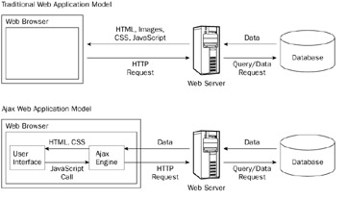
Architecture

Slide 6
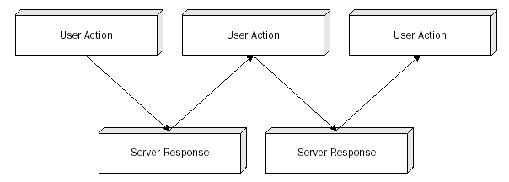
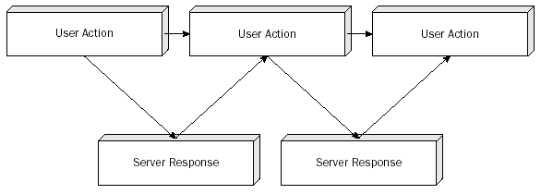
Problems AJAX Solved
Post Backs
Execute…
________________Vs________________
Asynchronous

Slide 7
Microsoft ASP.NET AJAX.NET
Installations
Implementation
AJAX.NET Controls

Slide 8
Installation
AJAX.NET is now provided with Visual Studio .Net 2010 by default.
There are no special requirements and no extra downloads required to developed AJAX enabled Web Applications.
Older versions are AJAX.NET downloadable from www.asp.net/ajax for Visual Studio .Net 2005 and 2008

Slide 9
AJAX.NET Examples
Hello World AJAX.NET Style
Update Progress Control
Timer Control

Slide 10
Where is AJAX.NET
Who is developing…
  AjaxPro
  Sarissa (http://sarissa.sourceforge.net/doc)
  MockiKit (http://www.mochikit.com)
  ComfortASP.NET (www.comfortasp.de)
  MagicAJAX (www.magicajax.net)
  Anthem.Net (http://anthem-dot-net.sourceforge.net)

Slide 11
Where is AJAX.NET
Who is using…
  BBC (www.bbc.co.uk)
  Ebay (www.ebay.com)
  Wikipedia (http://en.wikipedia.com)
  MySpace (www.myspace.com)
  Amazon (www.amazon.com)
  A9 (http://a9.amazon.com)
  Microsoft (www.microsoft.com)
  Google
    http://news.google.com
    http://maps.google.com
    http://gmail.com
    http://calender.google.com
Ref. http://getahead.ltd.uk/dwr/ajax/who

Slide 12
AJAX.NET Control Toolkit
ASP.NET AJAX Control Toolkit is a joint project between the community and Microsoft that provides a rich array on controls for building interactive Web experiences easily.
Downloadable from http://www.codeplex.com/AtlasControlToolkit/Release/ProjectReleases.aspx?ReleaseId=11121
The ASP.NET AJAX Control Toolkit is a collection of samples and components that show you some of the experiences you can create with ASP.NET AJAX controls and extenders. The Control Toolkit provides samples and a powerful SDK to make it simple to create and reuse custom controls and extenders.

Slide 13
AJAX.NET Extender Controls
The ExtenderControl class enables you to programmatically add AJAX functionality to an ASP.NET server control. The ExtenderControl inherits from the Control class and implements the IExtenderControl interface. The Control class defines the properties, methods, and events that are shared by all ASP.NET server controls. The IExtenderControl interface is an abstract class, which you cannot instantiate directly. Instead, you create a derived type.

Slide 14
AJAX.NET Control Example
TextBox Watermark Example
Accordian Example
Ajax Enabled Web Based Chat.

Slide 15


Slide 16
Questions
?

